Slide 1

School of Computing Science and Engineering
Weather Forecasting Application
SUBMITTED BY –
Sahil Prajapati(23SCSE1180442)
Shobhit Kumar Attri (23SCSE1180416)
Rahul(23SCSE1180282)
Ayush Singh (23SCSE1180380)
Of B.TECH CSE with AI & ML
Section 6

Slide 2

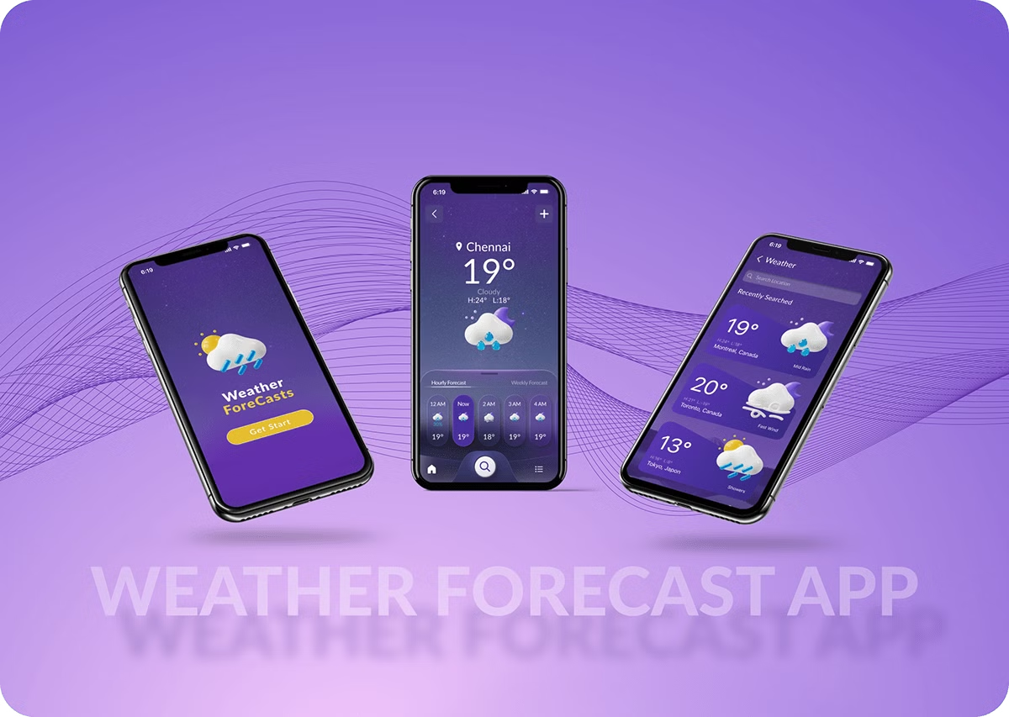

Weather Forecasting Application
This weather forecasting application leverages cutting-edge Java programming to provide accurate and real-time weather information to users. By combining advanced meteorological data analysis with intuitive user interface design, this app empowers people to better plan their daily activities and stay prepared for changing weather conditions.

Slide 3
Overview of the Application
Key Components
Data Sources
Algorithms
The application consists of a data gathering module, a forecasting engine, and a user-friendly interface.
It integrates weather data from government agencies, private weather stations, and satellite imagery.
Sophisticated machine learning and predictive analytics algorithms power the forecasting capabilities.

Slide 4

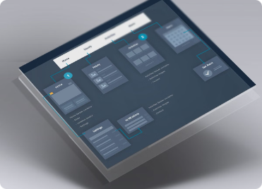
Flowchart Design and Thought Process
Data Collection
1
Gather real-time weather data from multiple sources, including sensors, satellites, and weather stations.
2
Data Processing
Clean, normalize, and analyze the collected data using advanced algorithms and machine learning models.
Forecasting
3
Generate accurate short-term and long-term weather predictions based on the processed data.

Slide 5

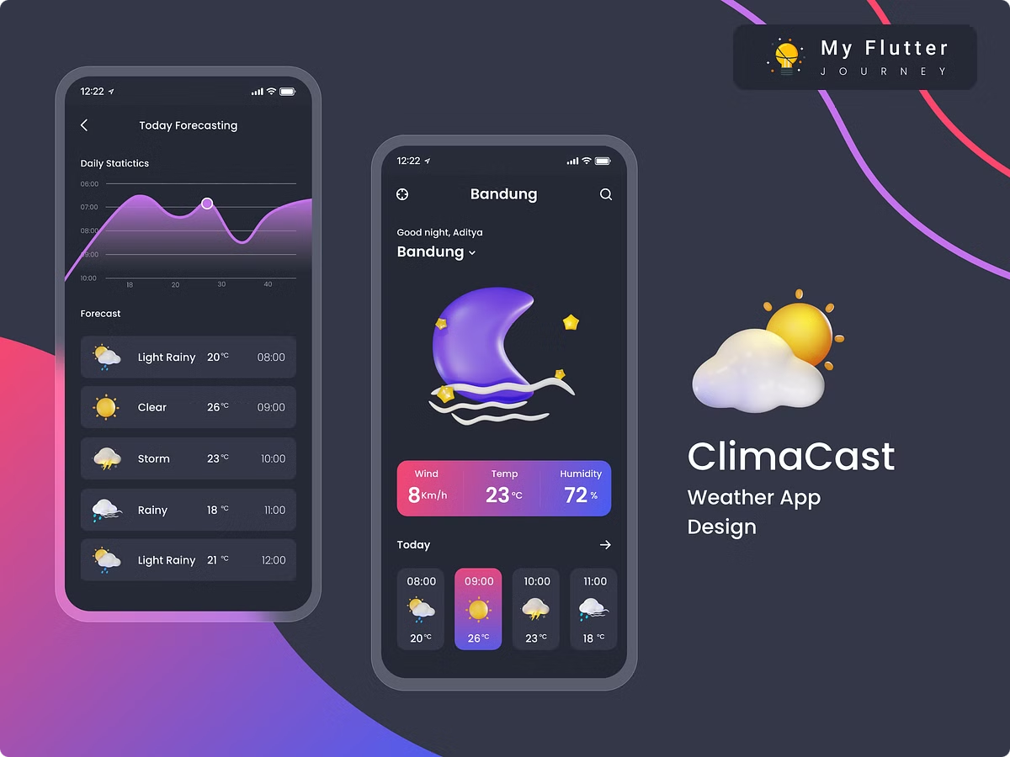
Key Features and Functionalities
1
Hyperlocal Forecasts
2
Personalized Alerts
Provide detailed, location-specific weather predictions with high accuracy and reliability.
Send push notifications and alerts for severe weather events, allowing users to stay prepared.
3
Historical Data Analysis
4
Customizable Dashboards
Analyze past weather patterns and trends to improve forecasting capabilities over time.
Allow users to personalize the app interface and view weather data in their preferred format.

Slide 6






Java Programming Fundamentals
Object-Oriented
Multithreading
The application is built using Java's object-oriented programming principles for modularity and scalability.
Efficient data processing and forecasting are achieved through the use of multithreading techniques.
Data Structures
API Integration
Advanced data structures, such as arrays, lists, and maps, are leveraged to store and manipulate weather data.
The application seamlessly integrates with various weather data APIs to gather real-time information.

Slide 7





Source Code Implementation
Data Gathering
Data Processing
Forecasting
Fetch weather data from diverse sources using the application's API integration capabilities.
Clean, normalize, and analyze the collected data using advanced algorithms and machine learning models.
Generate accurate short-term and long-term weather predictions based on the processed data.

Slide 8

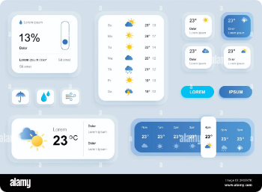
User Interface Design
Intuitive Layout
Responsive Design
The user interface is designed to be clean, intuitive, and easy to navigate, with clearly labeled sections and functionalities.
The application is optimized for various devices, ensuring a seamless user experience across smartphones, tablets, and desktops.
Customization Options
Accessibility Features
Users can personalize the app's appearance, units of measurement, and data visualization preferences to suit their needs.
The interface includes accessibility options, such as text-to-speech and high-contrast modes, to accommodate users with diverse needs.

Slide 9

Future Enhancements and Conclusion
1
Augmented Reality
2
Voice Interactions
Incorporate augmented reality features to provide immersive, location-based weather visualizations and simulations.
Integrate voice control and natural language processing to allow users to interact with the app using voice commands.
3
Predictive Analytics
Leverage advanced machine learning algorithms to improve long-term weather forecasting accuracy and reliability.
In conclusion, this weather forecasting application built with Java programming offers a comprehensive and user-friendly solution for individuals and organizations to stay informed and prepared for changing weather conditions.

Slide 10

Thank you
Thank you for considering our weather forecasting application. We are excited to showcase the power of Java programming.
Created by-
Sahil
Rahul
Shobhit
Ayush

